Slide 1

Project Title
TERM DEPOSIT ANALYSIS.

Slide 2
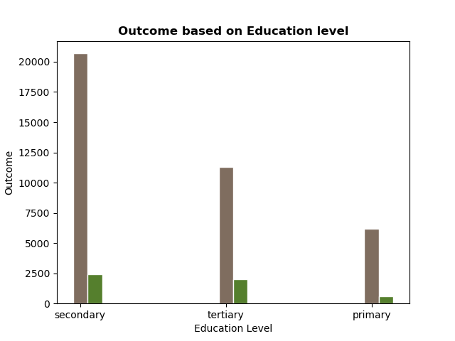
Analysis on Education Level
The chart shows that Education level does not have substantial effect on the term deposit purchase as the ratio of success to failure across all categories are almost the same.

Slide 3
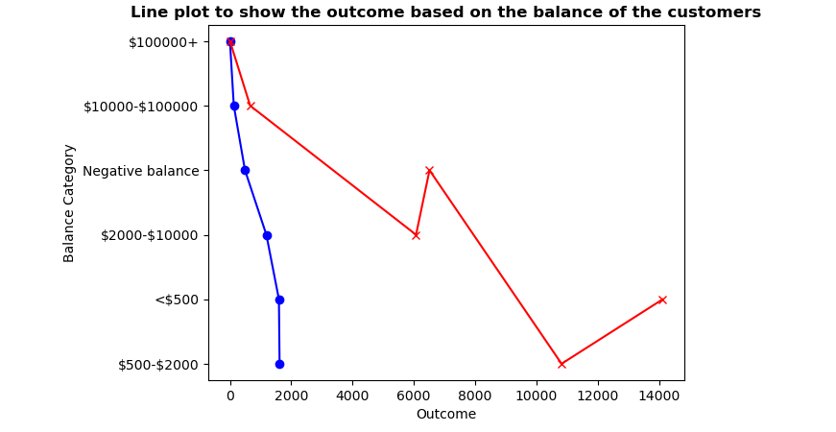
A scatter plot to show the relationship between the participant balance and the outcome.
The chart shows that more people with low balance purchase the term deposit but at the same time more failure was recorded for them, therefore it can be concluded that the balance does not determine the outcome.

Slide 4
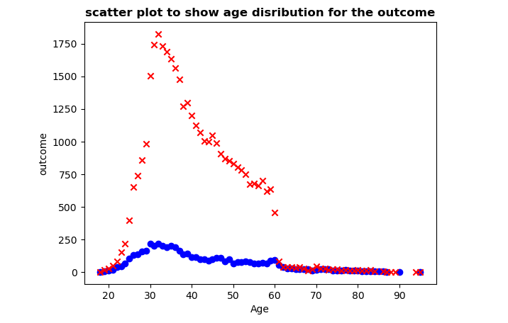
Analysis to Show the effect of Age on the Outcome
This chart shows the relationship between age and the outcome, it can also be concluded that there is no relationship between both except among the participant between the age of 60 to 90+ which shows a 50:50 ratio of success to failure.

Slide 5
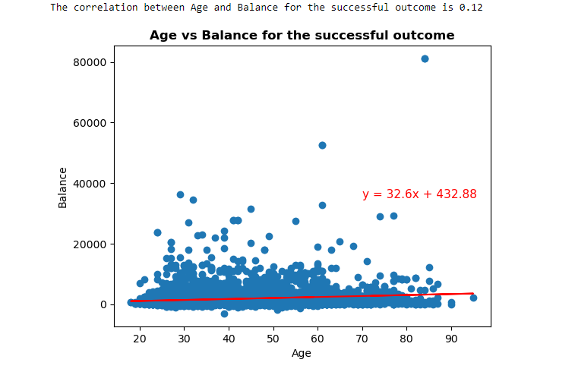
Analysis to Show the correlation coefficient between age & Balance
The chart shows the correlation between age and balance of participants that purchase the term deposit. It can be established that there is little or no correlation between the two factors.

Slide 6
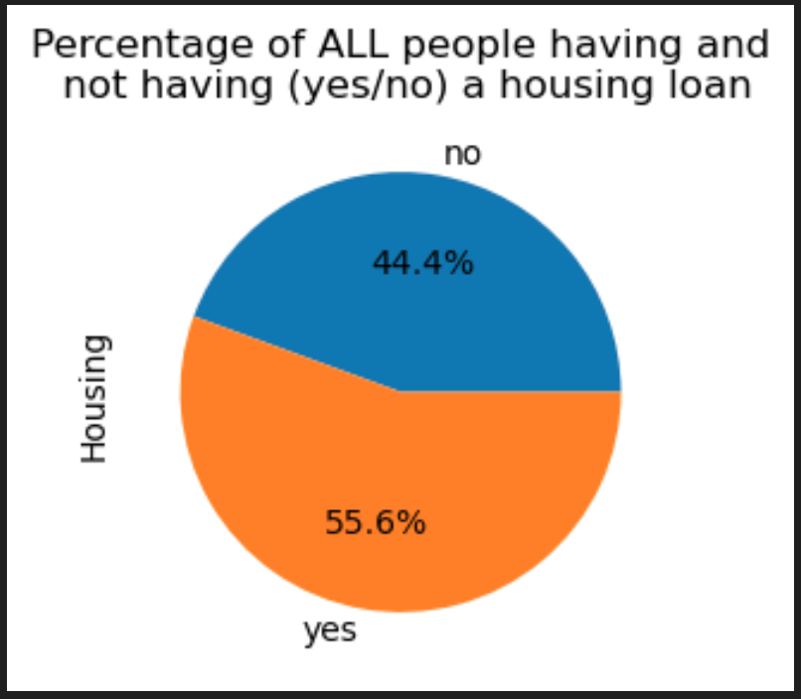
Analysis on Housing Loan
Having a house loan influences the purchase of term deposits?

Slide 7
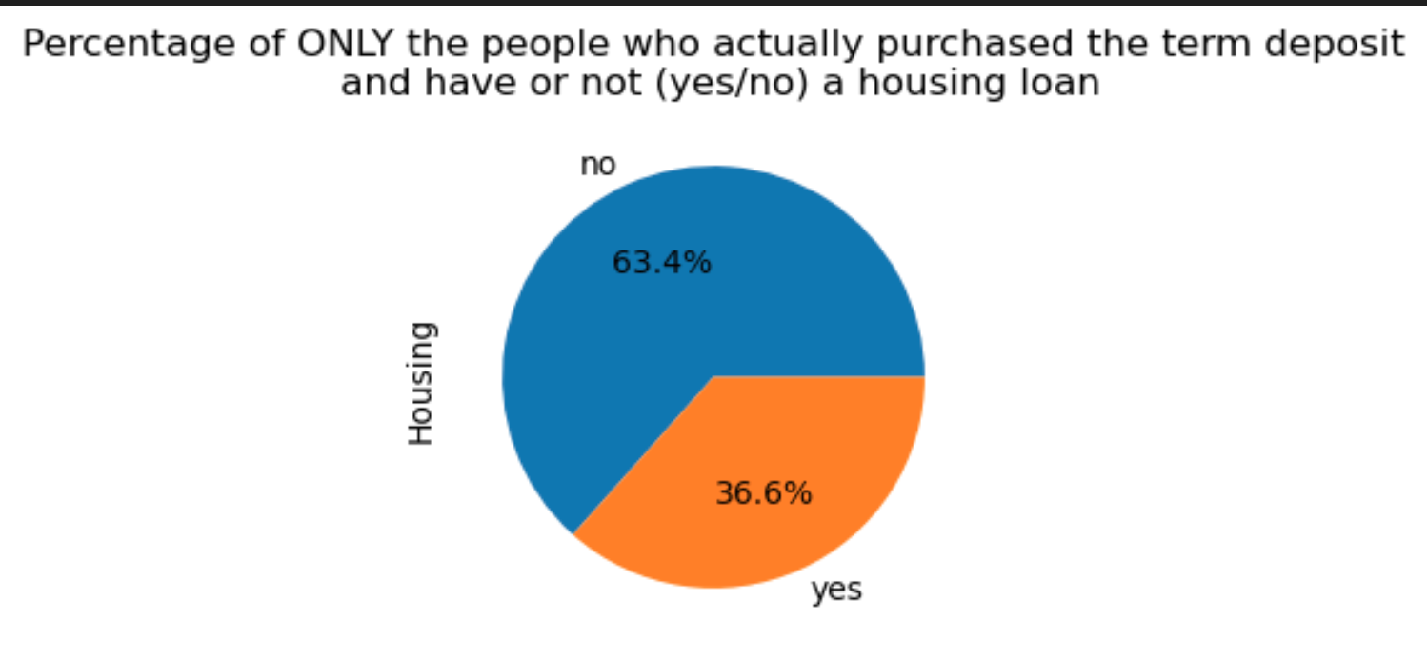
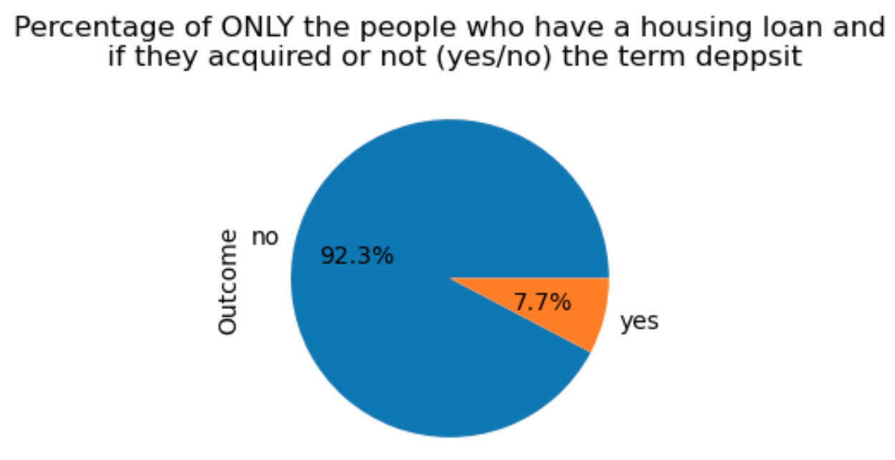
Analysis on Housing Loan
Analysis:
As a conclusion, there’s no clear relationship if having a housing loan affects the purchase of the product but a great % people who did purchase it does not have a housing loan

Slide 8
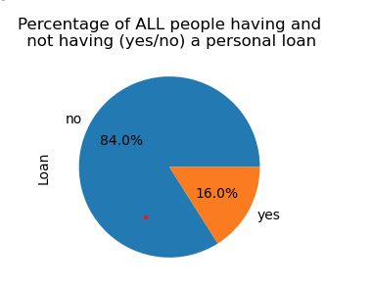
Analysis on Personal Loan
Having a personal loan influences the purchase of term deposits?

Slide 9
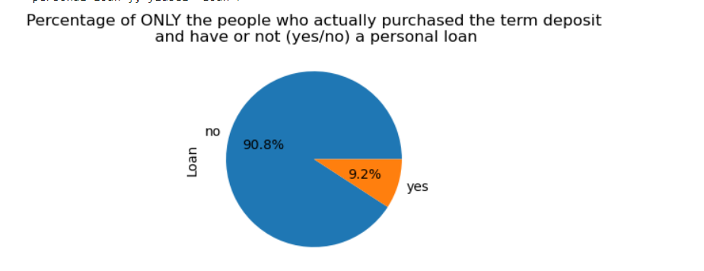
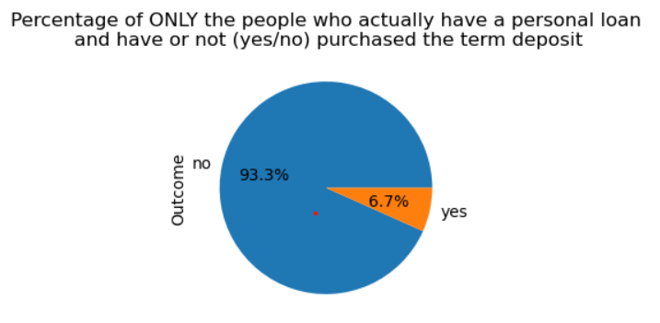
Analysis on Personal Loan
Analysis:
As a conclusion, because majority of people don’t have a personal loan, most of the people who
ended up purchasing the term deposit did not have
a personal loan

Slide 10
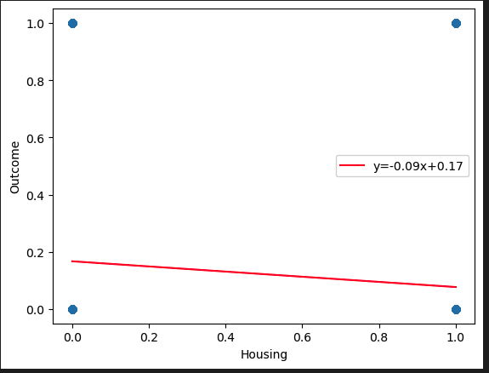
Correlation between Housing loan and Outcome
Conclusion:
The initial graph shows no evident relationship between having a housing loan and whether or not influences the decision of purchasing the product.
The second graph shows evidence that majority of the persons who bought the product did not have a housing loan.
However, after calculating their correlationship, there is no clear relationships between having or not a housing loan and purchasing a term deposit.

Slide 11
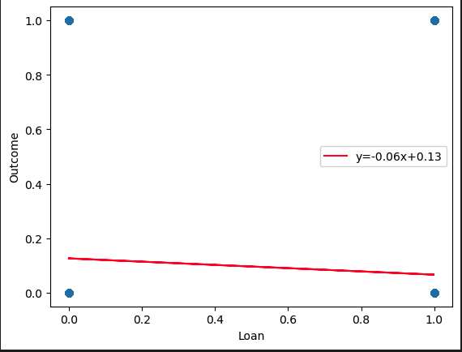
Correlation between Personal loan and Outcome
Conclusion:
The initial graph shows evident relationship between having a personal loan and whether or not influences the decision of purchasing the product.
As shown in the second graph as well, majority of the persons who bought the product did not have a personal loan.
After calculating their correlationship, there is no clear relationships between having or not a personal loan and purchasing a term deposit.

Slide 12
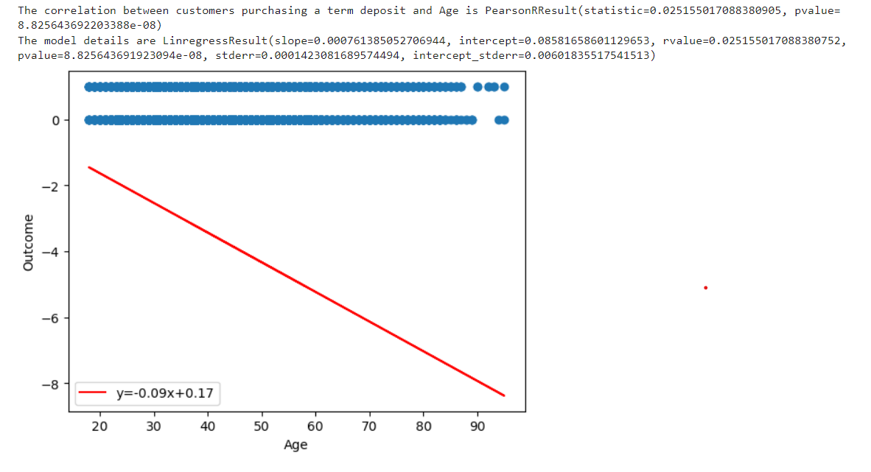
Correlation between Customers Purchasing a Term Deposit & Age Factor
Analysis:
For the Age we found it had very few outliers 303. We have used age as a valid factor to judge if it has influence on the outcome. The r value between age and out come is 0.025. so we concluded that age did not have enough influence on the outcome.

Slide 13
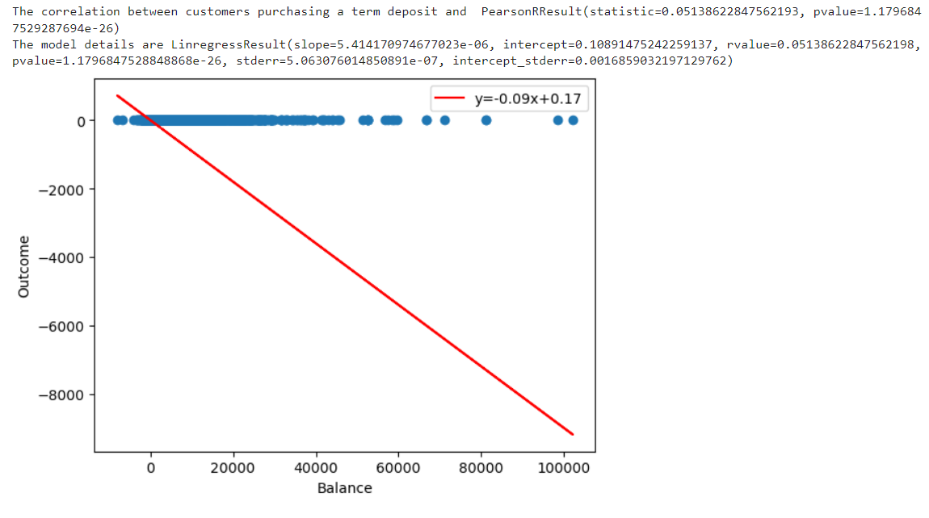
Correlation between Customers Purchasing a Term Deposit & Yearly Balance
Analysis:
For the Yearly Balance, we found it had very few outliers. We have used Yearly Balance as a valid factor to judge if it has influence on the outcome. The r value between Balance and out come is 0.051. So, we concluded that Yearly Balance did not have enough influence on the outcome.

Slide 14
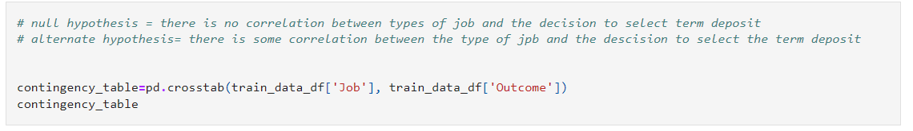
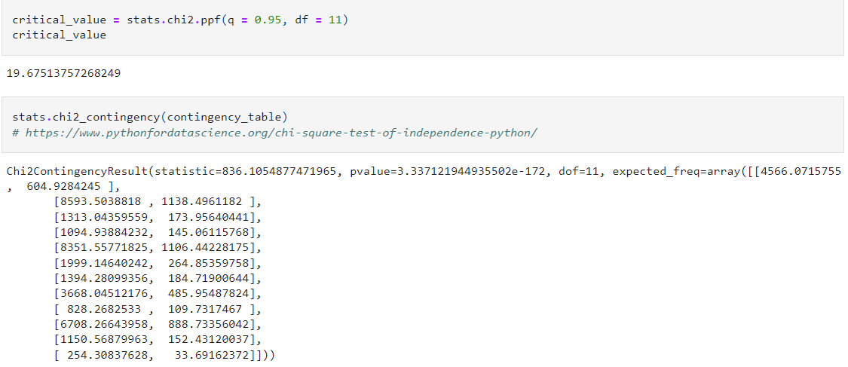
Correlation between types of Job and Outcome using Statistical Test
Analysis:
Null hypothesis = There is no correlation between of Job and the decision to select term deposit
Alternate hypothesis = There is some correlation between the types of Job and decision to select the term deposit
Analysis: On the basic of the Chi-Square test of independence in this case
p value >0.5. We can assume that there isn’t enough evidence Supporting. The hypothesis that jobs have effect on the purchasing of term deposit and so, we will accept the null hypothesis

Slide 15
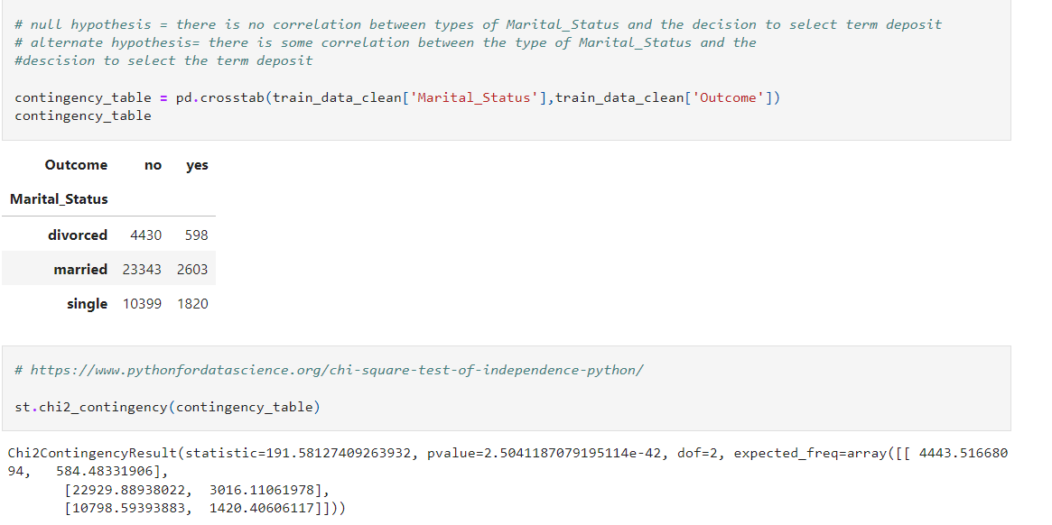
Correlation between types of Marital Status and Outcome using Statistical Test
Analysis:
Null hypothesis = There is no correlation between types of Marital Status and the decision to select term deposit.
Alternate hypothesis = There is some correlation between the types of Martial Status and the decision to select the term deposit.
Analysis: Using the chi square test of independence in this case since p value>0.05 we can assume that there isn't enough evidence supporting the hypothesis that Marital Status have effect on the purchasing of term deposit and so we will accept the null hypothesis

Slide 16
Overall Conclusion
Q.1: Considering various factors such as ( age, balance, education, housing
loan, personal loan and marital status), How does this factor affect
term deposit?
Conclusion: From the previous analysis we can conclude that all the factors
have low correlation with the outcome and we can also say the data is not
enough to calculate the relation with each other. So, none of the factor has
strong effect for term deposit.
Q.2: Which factors have Most influence and correlation with the result?
Conclusion: From the current analysis we were able to determine that in term
of demographic factors not having an influence on the decision to select Term
deposit needs more to be backed up by more data The data related to the
promotion of the and how the project was presented to the sample is also
included in it. The analysis related to how the Term deposit was presented
Should be studied separately and with the relation to the demographics.
Q.3: What is the relation between the education and Success Term Deposit? Conclusion: There is no significant relation between the education and term deposit.

Slide 17


